Slide 1
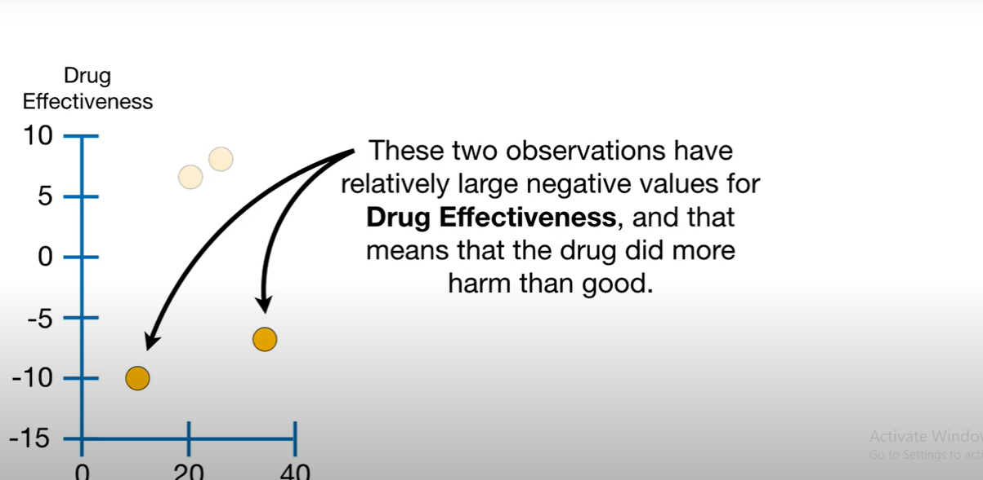

Slide 2
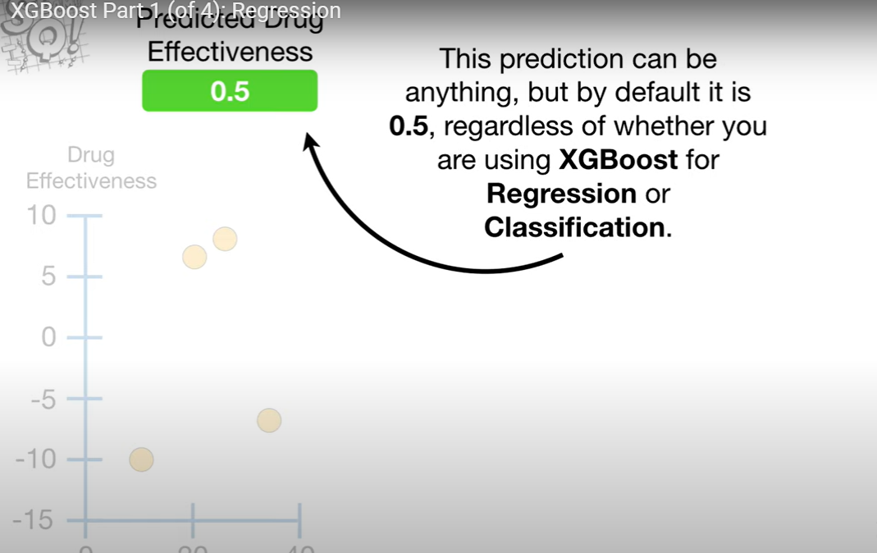

Slide 3
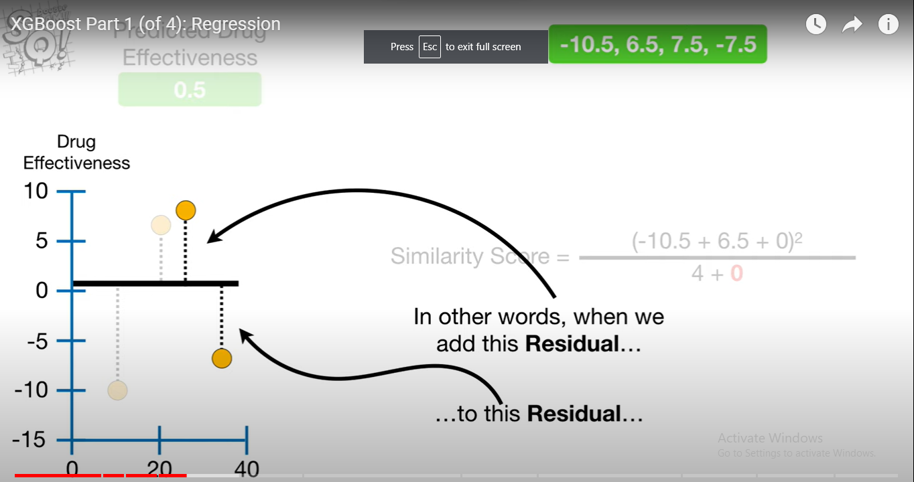

Slide 4
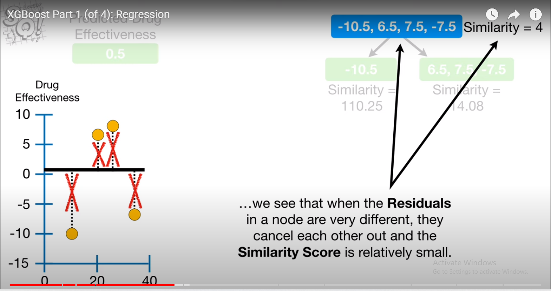

Slide 5
Link
https://medium.com/@prathameshsonawane/xgboost-how-does-this-work-e1cae7c5b6cb

